Slide 1
Idaho Advanced Nuclear Task Force
Scott Bedke, Lieutenant Governor, State of Idaho, Co-Chair
John Wagner, Director, Idaho National Laboratory, Co-Chair
February 2, 2026 | Boise, Idaho

Slide 2
Opening Remarks & Kickoff
Brad Little, Governor of Idaho

Slide 3
Call to Order and Meeting Kickoff
Lt Gov. Scott Bedke, Co-Chair
Director John Wagner, Co-Chair

Slide 4
DOE Updates
Dr. Mike Goff, Principal Deputy Assistant Secretary for the
Office of Nuclear Energy, U.S. Department of Energy

Slide 5
Break

Slide 6
Reactor Projects Panel
Tim Frazier, VP of Government Programs, Aalo Atomics
Jason Andrus, Director of Licensing, Antares Industries
Everett Redmond, Senior Director of Federal Affairs, Oklo, Inc.

Slide 7
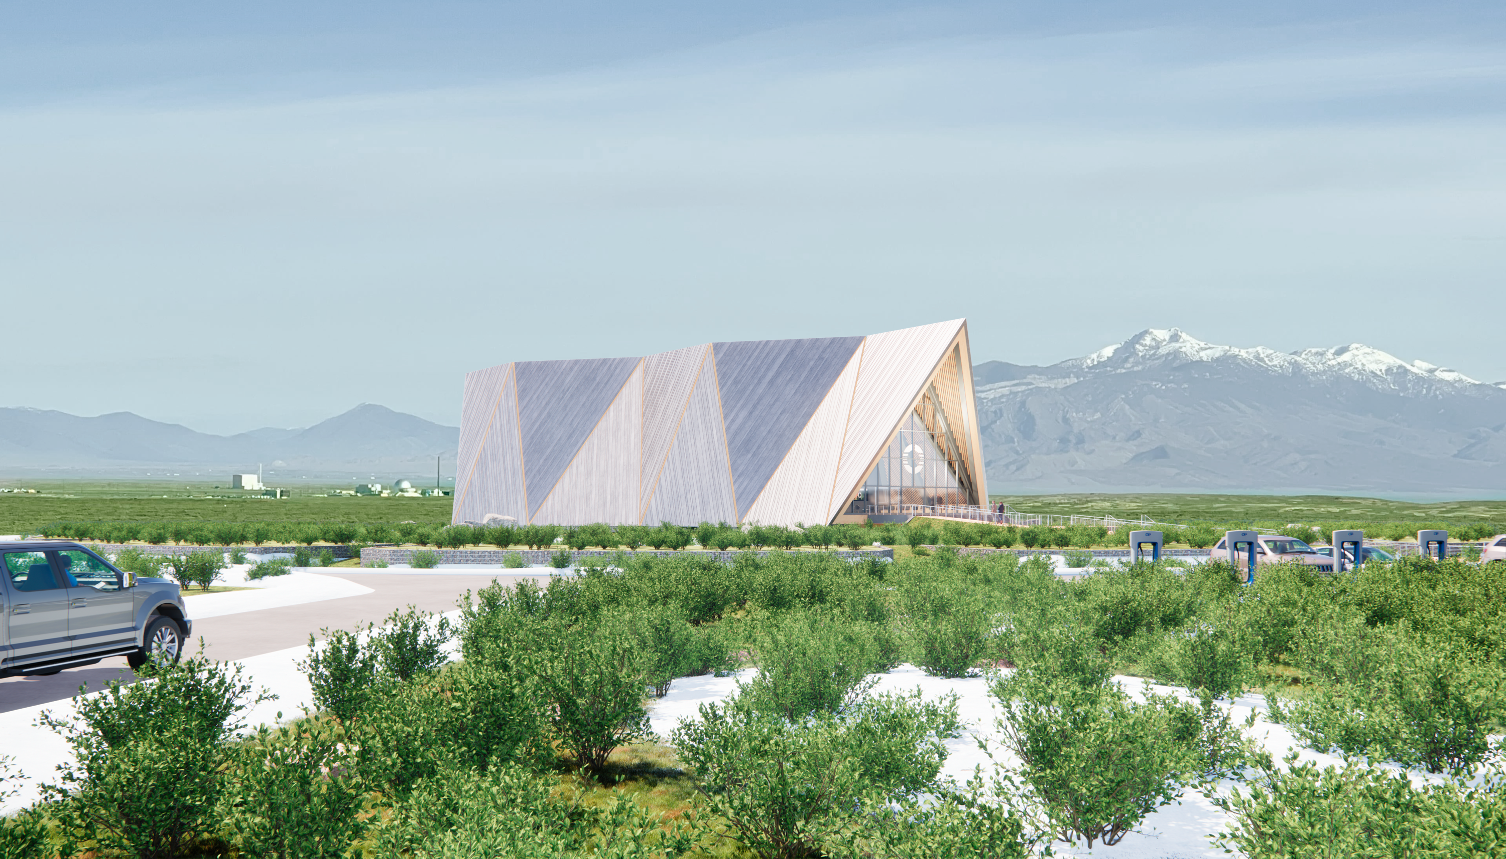

Idaho Advanced Nuclear Energy Task Force
February 2, 2026
Everett Redmond, Ph.D.

Slide 8
Forward-looking statements
ABOUT THIS PRESENTATION
This presentation is provided by Oklo Inc. (“Oklo”) for informational purposes only. The information contained herein does not purport to be all inclusive and no representations or warranties, express or implied, are given in, or in respect of, this presentation. To the fullest extent permitted by law, in no circumstances will Oklo or any of its subsidiaries, interest holders, affiliates, representatives, partners, directors, officers, employees, advisers or agents be responsible or liable for any direct, indirect or consequential loss or loss of profit arising from the use of this presentation, its contents, its omissions, reliance on the information contained within it, or on opinions communicated in relation thereto or otherwise arising in connection therewith.
NO OFFER OR SOLICITATION
This presentation does not constitute an offer to sell or the solicitation of an offer to buy any securities, or a solicitation of any vote or approval, nor shall there be any sale of securities in any jurisdiction in which such offer, solicitation or sale would be unlawful prior to registration or qualification under the securities laws of any such jurisdiction. This presentation is not, and under no circumstances is to be construed as, a prospectus, an advertisement or a public offering of the securities described herein in the United States or any other jurisdiction. No offer of securities shall be made except by means of a prospectus meeting the requirements of Section 10 of the Securities Act of 1933, as amended, or exemptions therefrom.
NO REPRESENTATIONS OR WARRANTIES
This presentation is for informational purposes only and does not purport to contain all of the information that may be required to evaluate Oklo. Viewers of this presentation should make their own evaluation of Oklo and of the relevance and adequacy of the information and should make other investigations as they deem necessary. This presentation is not intended to form the basis of any investment decision by any potential investor and does not constitute investment, tax or legal advice. No representations or warranties, express or implied, are or will be given in, or in respect of, this presentation or any other written, oral or other communications transmitted or otherwise made available to any party in the course of its evaluation of an investment in Oklo, and no responsibility or liability whatsoever is accepted for the accuracy or sufficiency thereof or for any errors, omissions or misstatements, negligent or otherwise, relating thereto. To the fullest extent permitted by law, in no circumstances will Oklo or any of its subsidiaries, interest holders, affiliates, representatives, partners, directors, officers, employees, advisers or agents be responsible or liable for any direct, indirect or consequential loss or loss of profit arising from the use of this presentation, its contents, its omissions, reliance on the information contained within it, or on opinions communicated in relation thereto or otherwise arising in connection therewith. The information contained in this presentation is preliminary in nature and is subject to change, and any such changes may be material. Oklo disclaims any duty to update the information contained in this presentation.
FORWARD-LOOKING STATEMENTS
This presentation includes statements that express Oklo’s opinions, expectations, objectives, beliefs, plans, intentions, strategies, assumptions, forecasts or projections regarding future events or future results and therefore are, or may be deemed to be, “forward-looking statements.” The words “anticipate,” “believe,” “continue,” “could,” “estimate,” “expect,” “intends,” “may,” “might,” “plan,” “possible,” “potential,” “predict,” “project,” “should,” “would” or, in each case, their negative or other variations or comparable terminology, and similar expressions may identify forward-looking statements, but the absence of these words does not mean that a statement is not forward-looking. These forward-looking statements include all matters that are not historical facts. They appear in a number of places throughout this presentation and include statements regarding our intentions, beliefs or current expectations concerning, among other things, the timing, goals and benefits of nuclear fuel recycling, environmental benefits and goals of Oklo’s projects, results of operations, financial condition, liquidity, prospects, growth, strategies and the markets in which Oklo operates. Such forward-looking statements are based on information available as of the date of this presentation, and current expectations, forecasts and assumptions, and involve a number of judgments, risks and uncertainties.
As a result of a number of known and unknown risks and uncertainties, the actual results or performance of Oklo may be materially different from those expressed or implied by these forward-looking statements. The following important risk factors could affect Oklo’s future results and cause those results or other outcomes to differ materially from those expressed or implied in the forward-looking statements: risks related to the deployment of Oklo’s powerhouses; the risk that Oklo is pursuing an emerging market, with no commercial project operating, regulatory uncertainties; the potential need for financing to construct plants; market, financial, political, environmental and legal conditions; the effects of competition; changes in applicable laws or regulations; the outcome of any government and regulatory proceedings and investigations and inquiries.
The foregoing list of factors is not exhaustive. You should carefully consider the foregoing factors and the other risks and uncertainties of the other documents filed by Oklo from time to time with the U.S. Securities and Exchange Commission. The forward-looking statements contained in this presentation and in any document incorporated by reference are based on current expectations and beliefs concerning future developments and their potential effects on Oklo. There can be no assurance that future developments affecting Oklo will be those that Oklo has anticipated. Oklo undertakes no obligation to update or revise any forward-looking statements, whether as a result of new information, future events or otherwise, except as may be required under applicable securities laws.
INDUSTRY AND MARKET DATA
In this presentation, Oklo relies on and refers to certain information and statistics regarding the markets and industries in which Oklo competes. Such information and statistics are based on Oklo’s management’s estimates and/or obtained from third party sources, including reports by market research firms and company filings. While Oklo believes such third party information is reliable, there can be no assurance as to the accuracy or completeness of the indicated information. Oklo has not independently verified the accuracy or completeness of the information provided by the third-party sources.

Slide 9



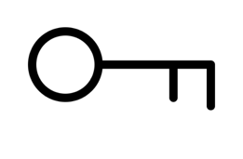
The Oklo Model
Our mission is to provide clean, reliable, and affordable energy
on a global scale
Oklo owns and operates the Aurora
Oklo offers long-term Power Purchase Agreements
Competitive pricing and terms
Lifecycle management of plant and fuel

Slide 10
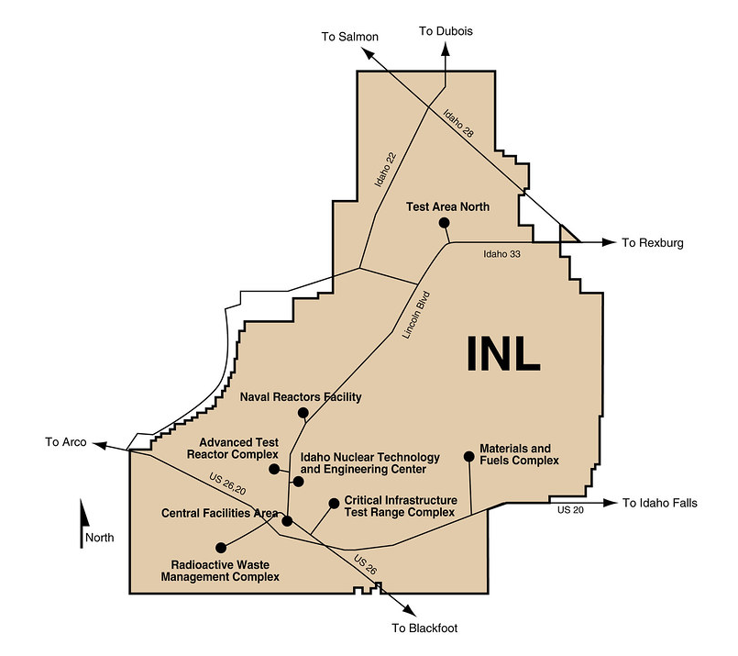
Oklo at Idaho National Laboratory
Aurora Fuel
Fabrication
Atomic Alchemy
Meitner 1
Aurora INL

Slide 11
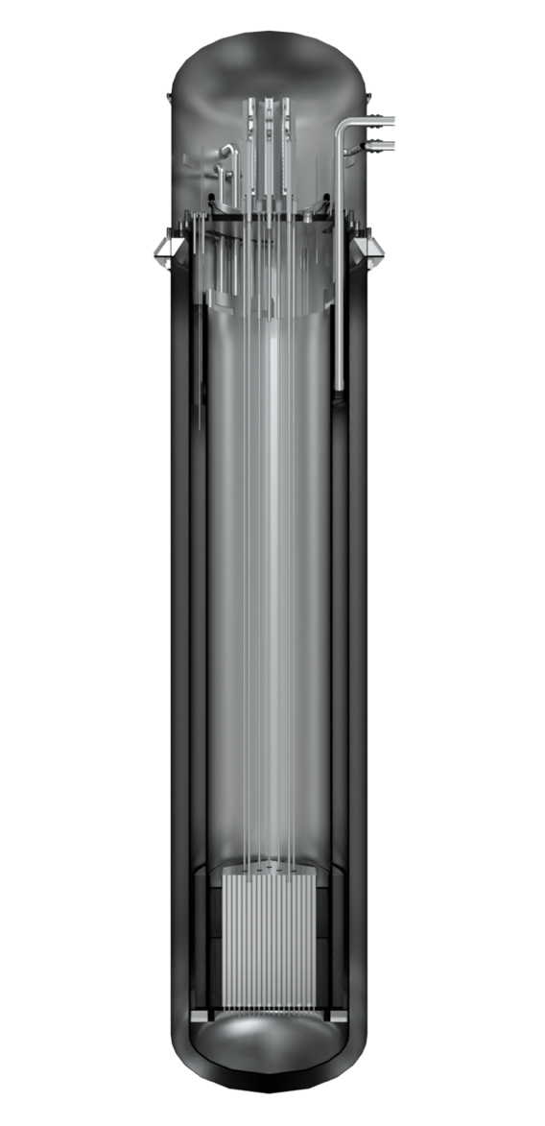
The Aurora Powerhouse – an advanced fast fission reactor
Reactor design features
Product benefits
Reaction type: Fast fission
Reactor sizes: 75 MWe, initial operation at reduced power level
Fuel: Metal fuel alloy, high assay low enriched uranium or recycled fuel
Coolant: Liquid metal sodium
Safety systems: Inherent and passive
Operating temperature: 450+ C
Operating pressure: Atmospheric
Power output license: 40+ years
Small and simple design
Low cost
Proven technology
Inherently safe
24/7 clean, reliable power
< 18 months installation (nth of a kind)
First Powerhouse to be U.S. Department of Energy authorized at INL utilizing 5 MTU of HALEU from processed EBR-II spent fuel – startup 2027/2028

Slide 12
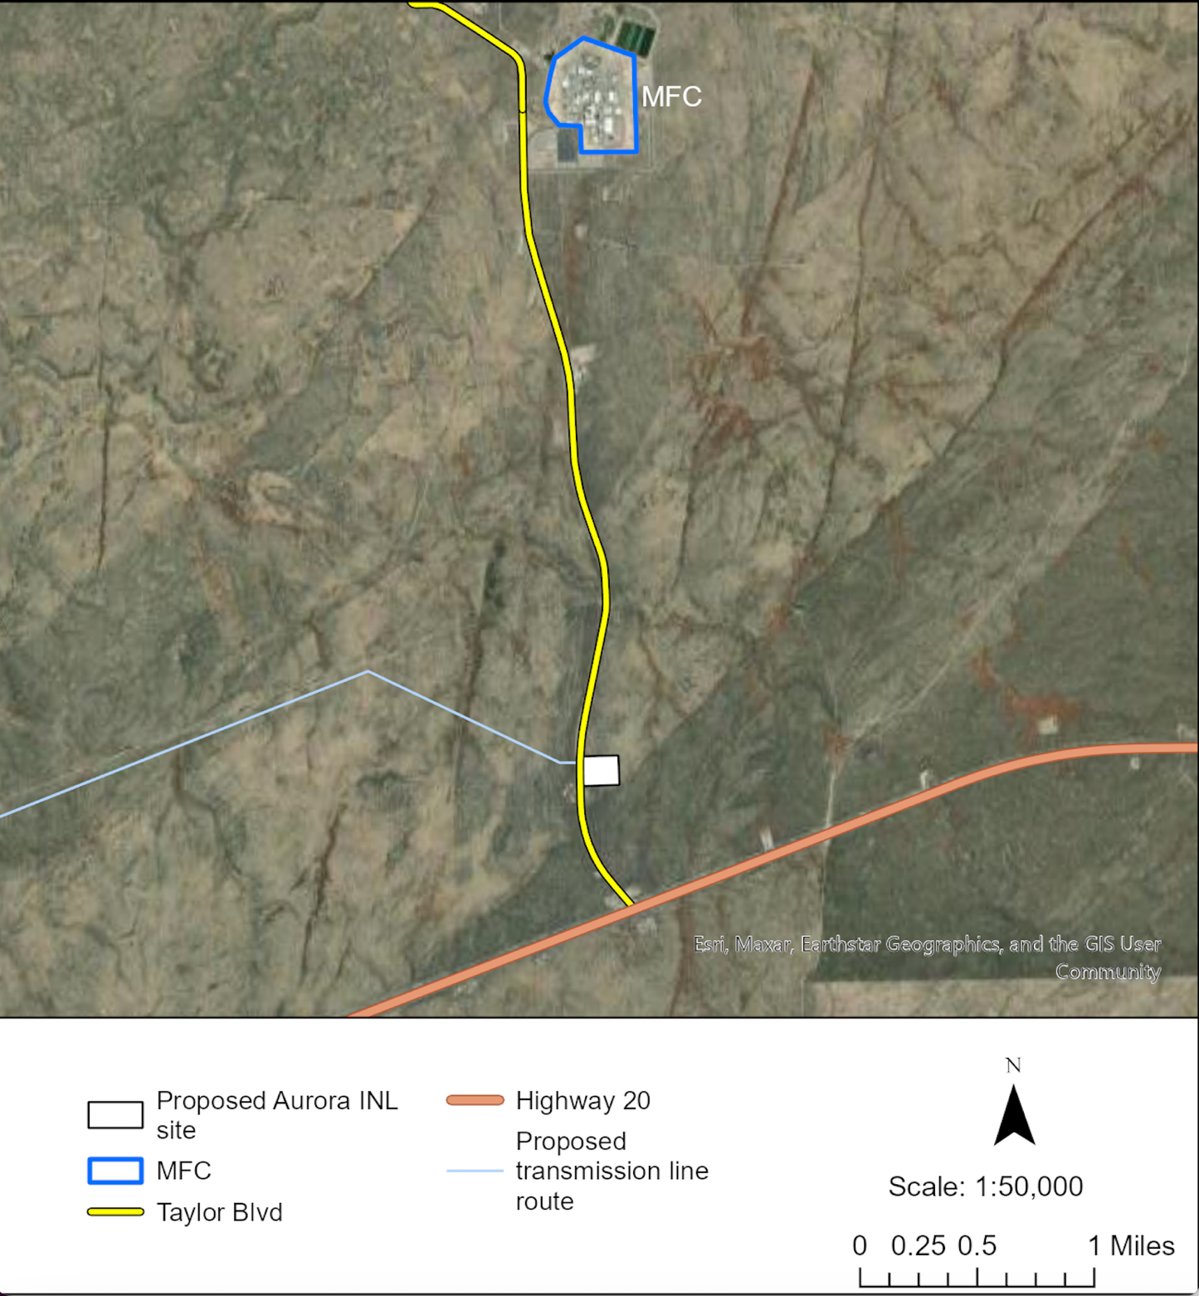
Site Related Activities
Cultural and biological surveys
Site characterization (geophysics testing and boreholes) work to support civil design
Construction underway
Oklo engaged with Idaho Power
Possible transmission lines routes shown
Idaho Falls
Oklo Site

Slide 13
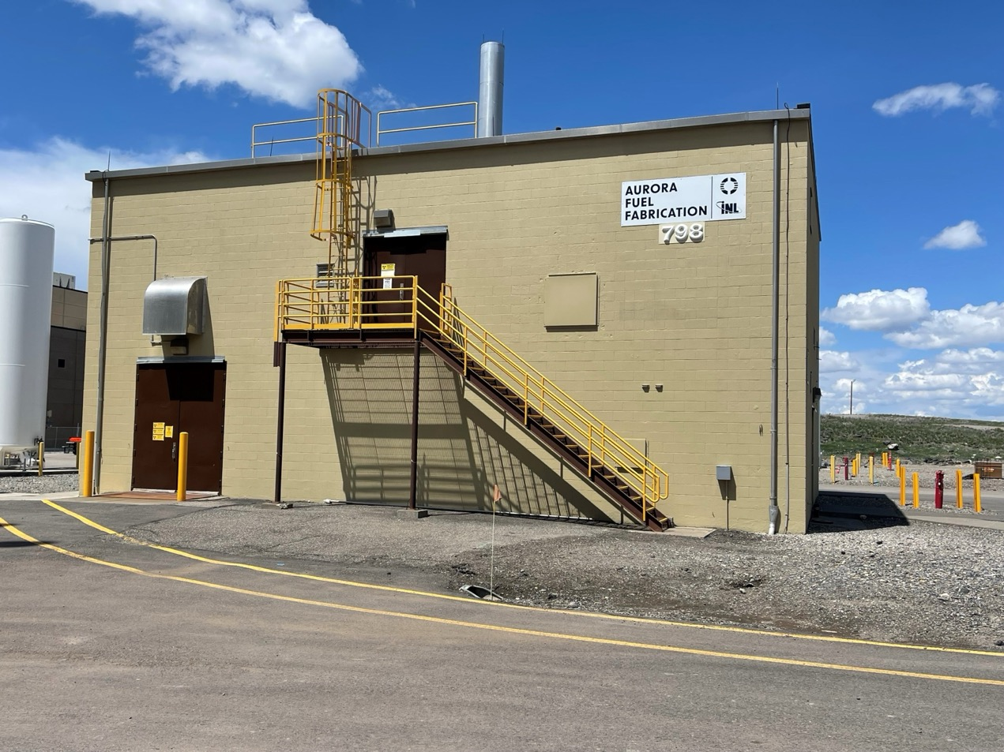
Fuel Fabrication
Oklo has been granted access to 5 metric tons of HALEU being produced from processed EBR-II spent fuel at Idaho National Laboratory (INL)
Building MFC-798 at INL will be converted into a pilot-scale fuel fabrication facility
The facility will be DOE authorized

Slide 14
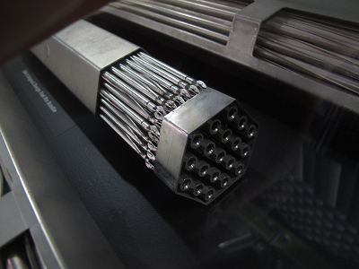
Aurora Reactor Fuel
Metal fuel inside fuel rods
Rods bundled together inside a metal can
Uranium enriched up to 19.75% in U-235
Similar in design to EBR-II

Slide 15
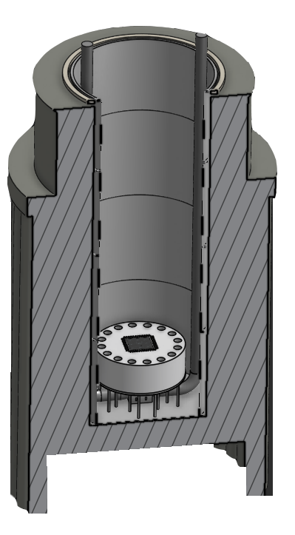
Atomic Alchemy – Meitner 1
Versatile isotope production reactor
Pool-type, water-cooled, non-pressurized isotope production reactor
Uses reduced height pressurized water reactor 17x17 fuel bundles and LEU fuel
Wide variety of irradiation positions
Goal is neutron production and diverse isotope production
Medical, defense, and industrial applications

Slide 16
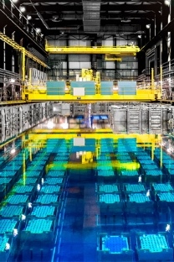
Recycling
Oklo is planning to recycle spent fuel for production of U/Transuranic material (U/TRU) and has engaged the U.S. Nuclear Regulatory Commission in pre-application interactions
Fast reactors + pyroprocessing = paradigm shift
Pyroprocessing technology based on decades of work at Idaho and Argonne National Laboratories
Initial feedstock is expected to be majority light water reactor oxide fuel, to be followed by advanced reactor metal fuel
Oklo will only deploy reprocessing technology in the U.S. in Oak Ridge, Tennessee

Slide 17
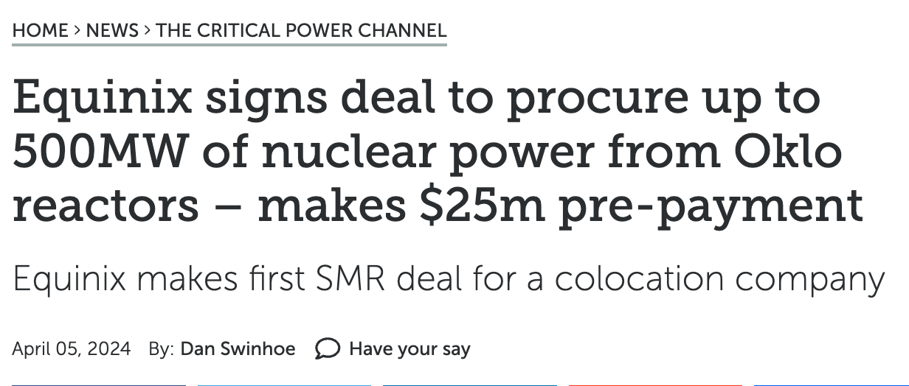
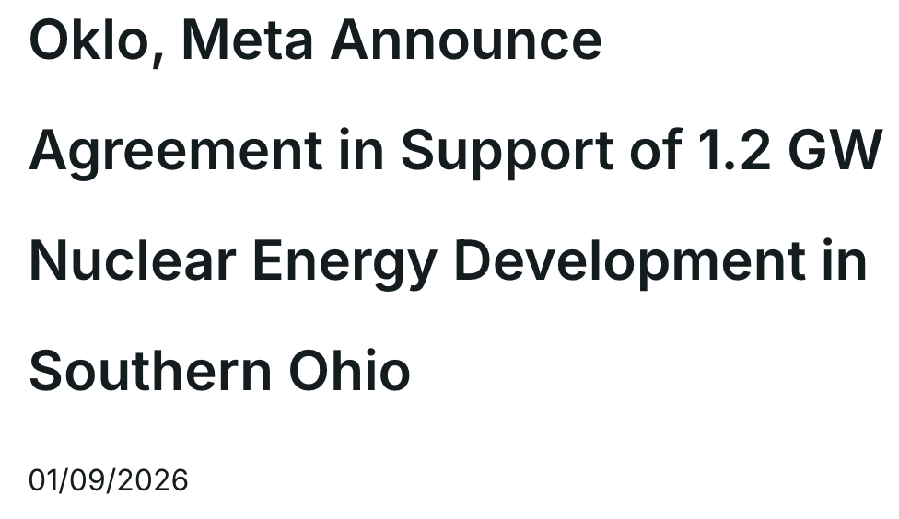
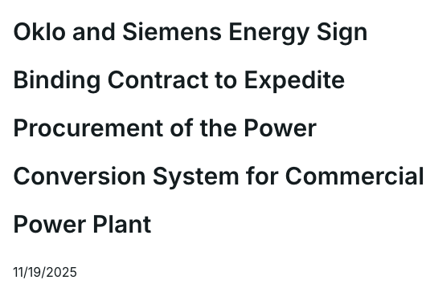
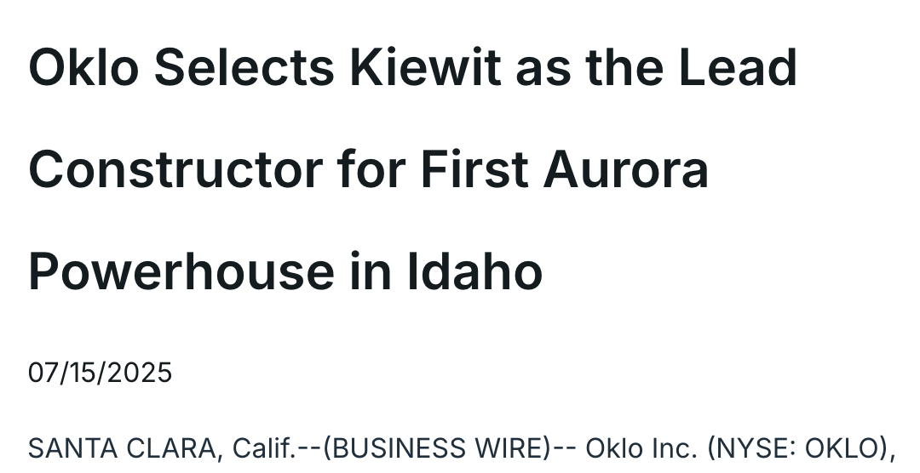
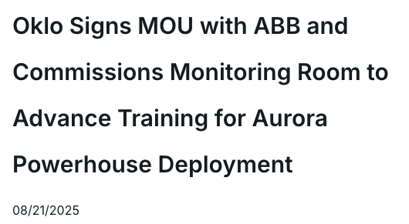
Oklo’s Customers and Partnerships
Data Center Dynamics article
Oklo press releases

Slide 18
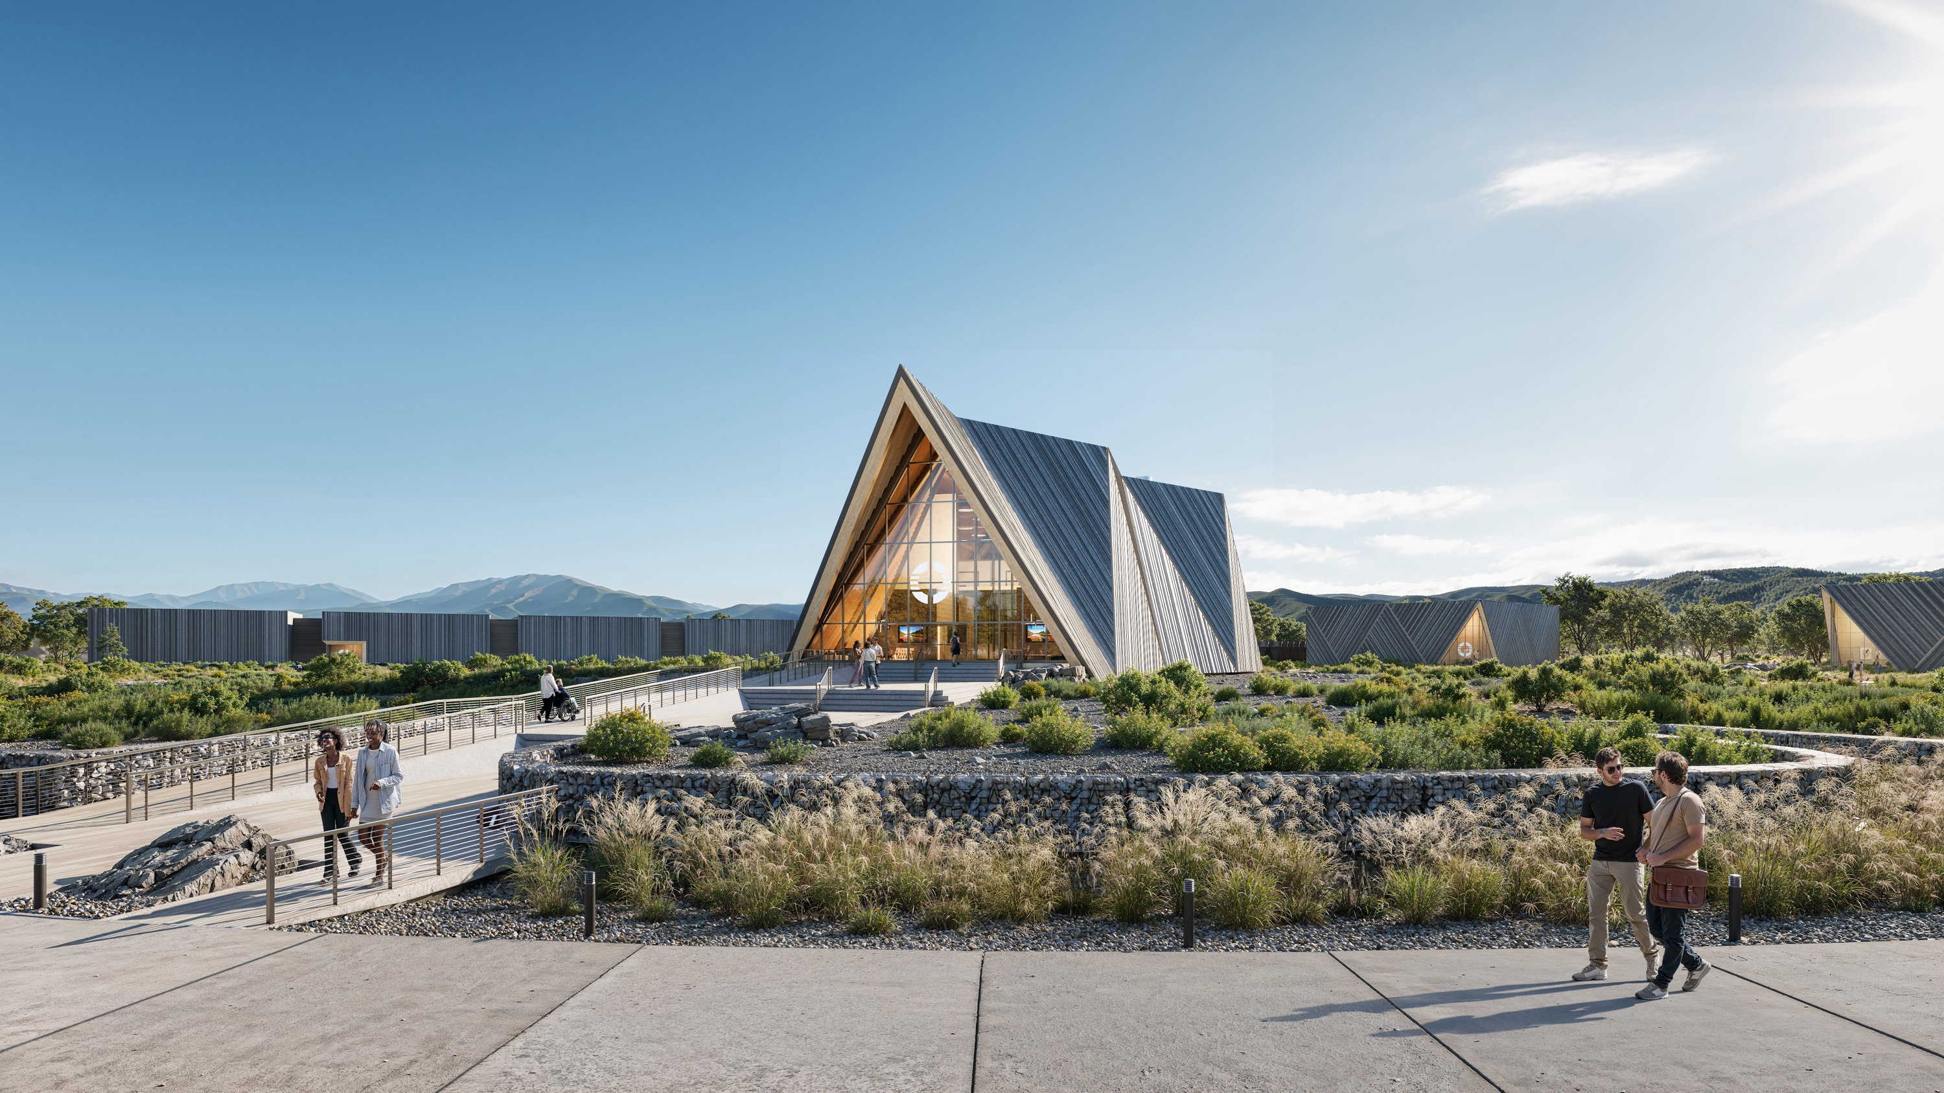
Questions?
everett@oklo.com
The Aurora Powerhouse

Slide 19
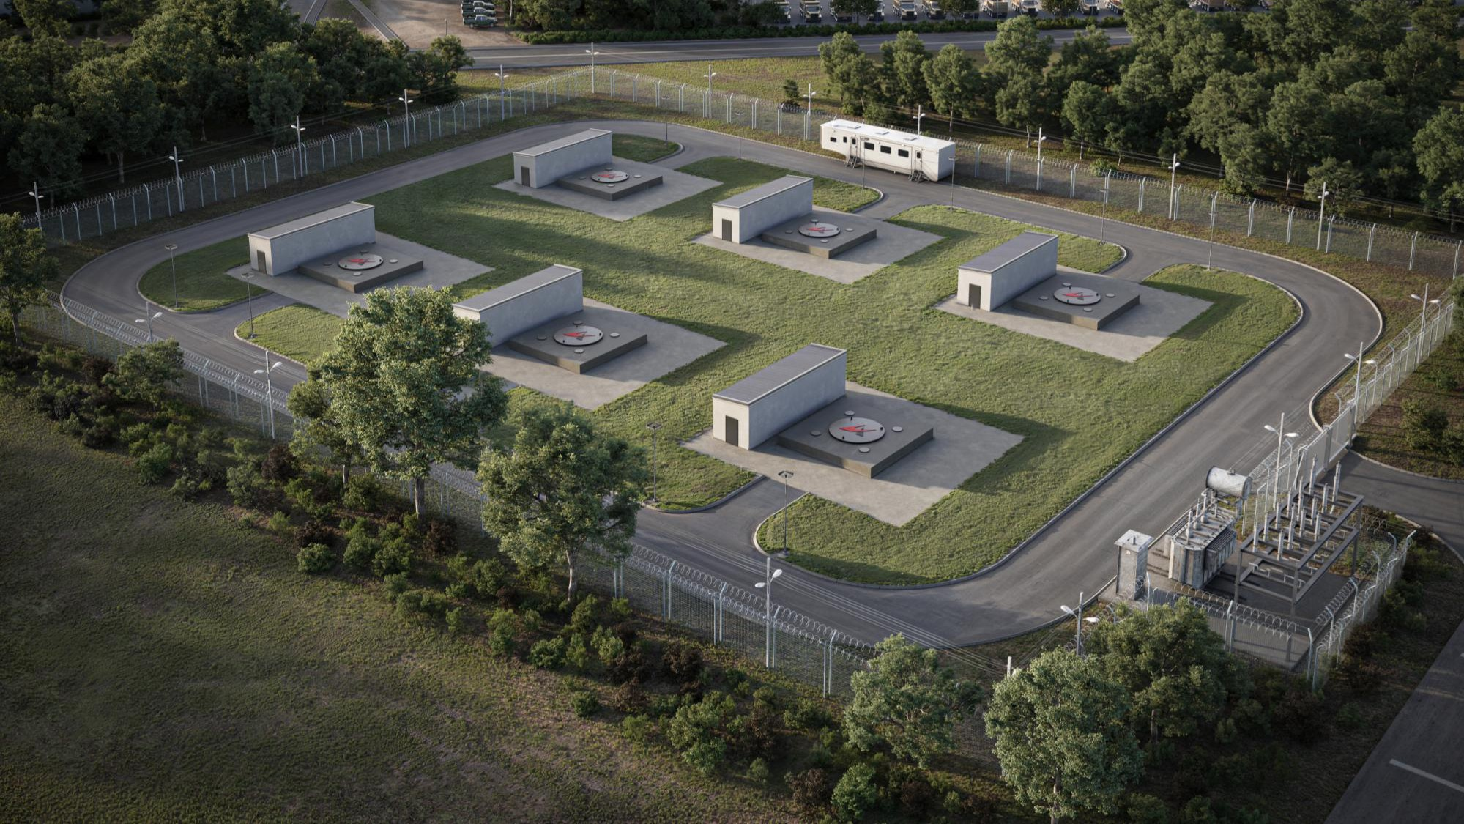


Slide 20
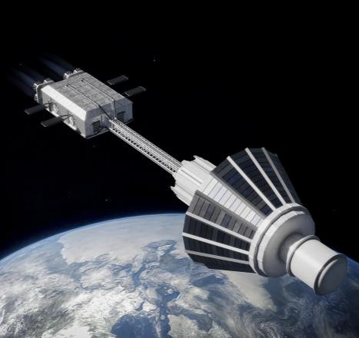
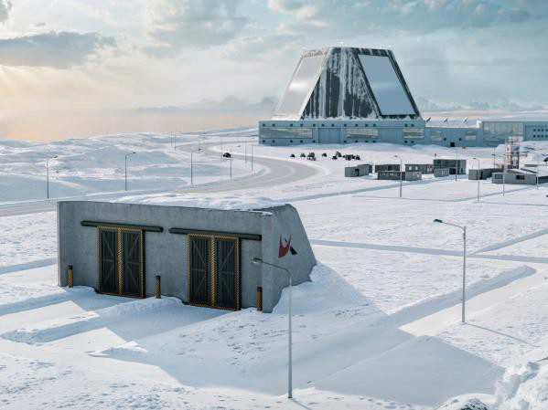
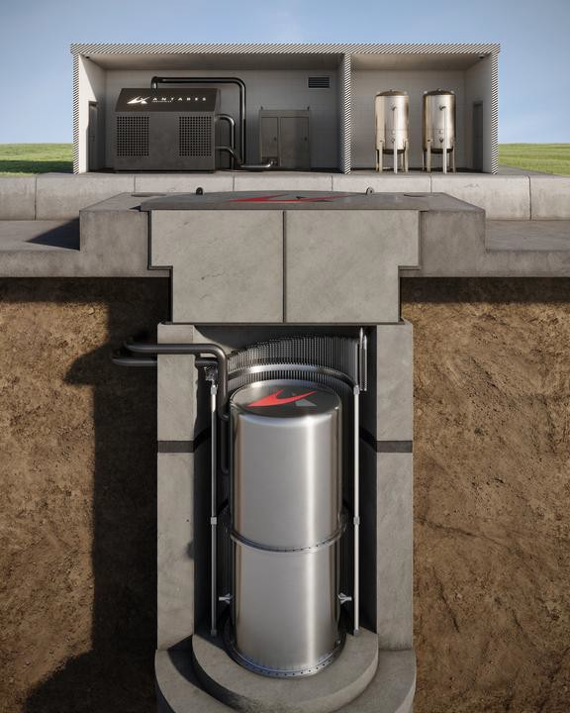

"Strategic Energy" is our mission
I N S P A C E P O W E R A N D P R O P U L S I O N
M I S S I O N C R I T I C A L F A C I L I T I E S
S T R A T E G I C E N E R G Y
D E P L O Y E D B E L O W G R A D E
Enable critical mission capabilities that are impossible without nuclear power.
Target 100 kWe - 2 MWe to power critical assets like missile defense sites and counter-space systems
Unlock clean, resilient, supply chain free power on earth and in space.
Deliver complete integrated solution to unlock mission effect, not just a "box of power"
2

Slide 21
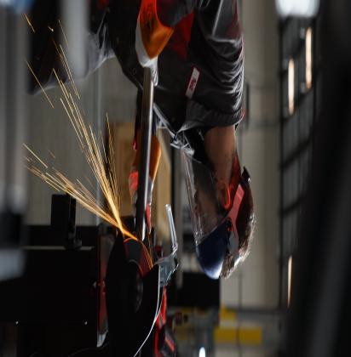
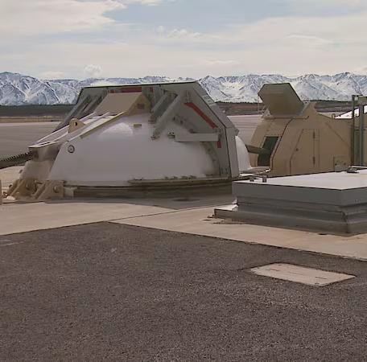
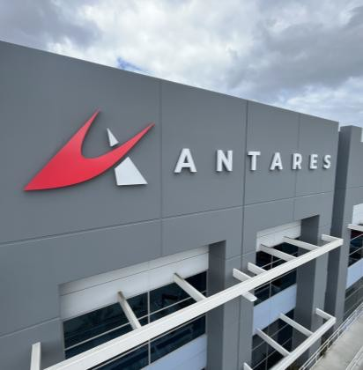
Antares is redefining nuclear energy.
W H O W E A R E
01. 02.
03.
04.
We design and build factory mass-producible, heat pipe–cooled micro nuclear reactors to power critical infrastructure — safely, efficiently, and reliably.
Our multidisciplinary team of 60+ experts from nuclear, aerospace, and defense industries is designing, manufacturing, and testing under an NQA-1 program.
Our defense-first focus de-risks supply chains and provides access to a first-move energy market.
Antares is partnering with DOD customers and winning contracts
to prove our technology.
322,000 sq. ft. facility, in Torrance, CA, capable of producing our first 50 reactors.
3

Slide 22
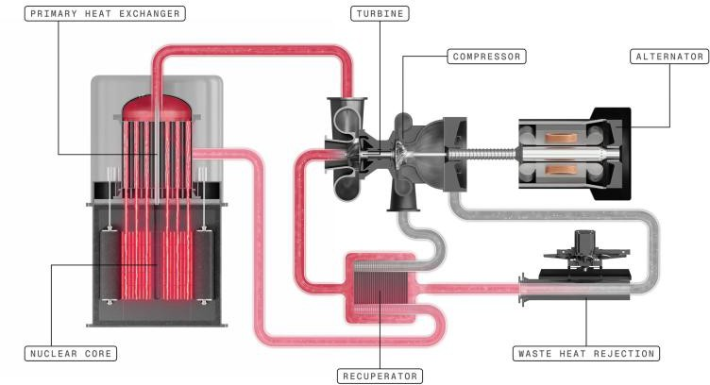
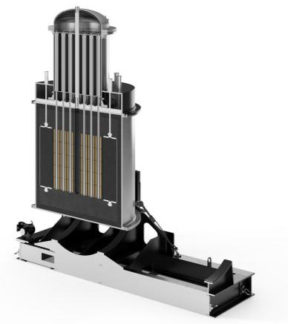
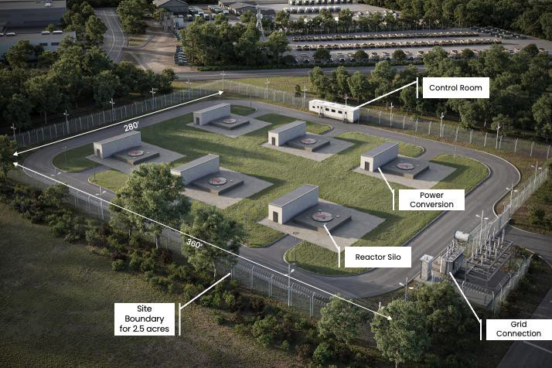
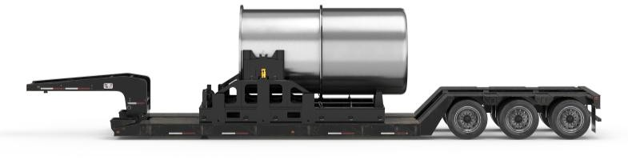
R1 Reactor
O U R S O L U T I O N
Reactor
1-3.3 Megawatt thermal. Capable of co-generation of heat and electricity. Scalable to higher power levels.
200-1000 Kilowatts electric for critical infrastructure resilience and remote power.
Six effective full-power years of clean energy without refueling.
TRISO Fuel (19.75% U-235).
Inherent safety with Generation IV technology
Power Conversion
Closed-loop nitrogen Brayton cycle provides reliable power in a wide range wide range of environments.
Site
Deployable to remote and austere locations
Minimal site footprint for co-location with user facilities
Power and heat applications can be custom configured
Safety and security with integrated protective features for radiation and external threats
Logistics
Scalable to power larger sites with co-
location of multiple reactors
Transportable by tractor-trailer, barge, palletized load system, rail.
4

Slide 23
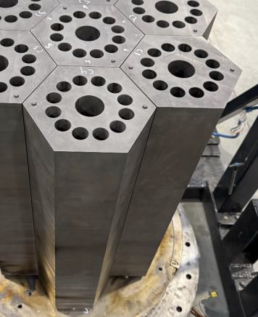
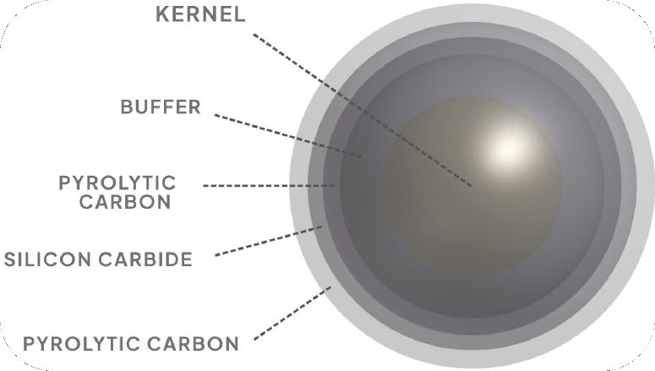
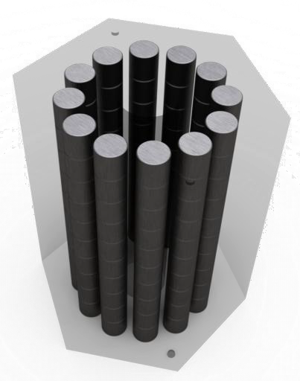
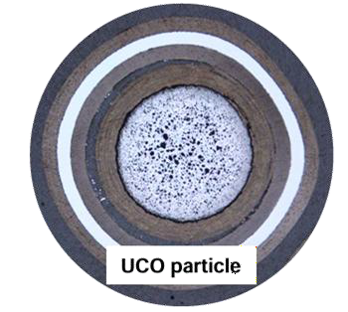
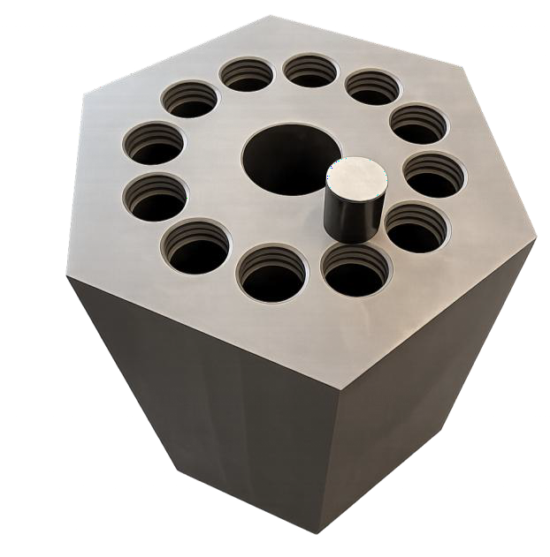
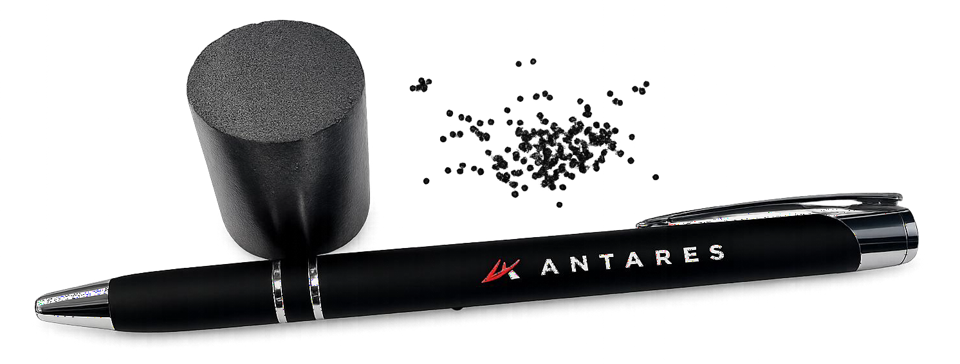
Safety is Founded in Our Fuel
“The Most Robust Nuclear Fuel on Earth” - DOE Office of Nuclear Energy
Modular Graphite Block Core Structure
TRISO Fuel Particles
425 µm
TRISO Fuel
Compact
5

Slide 24
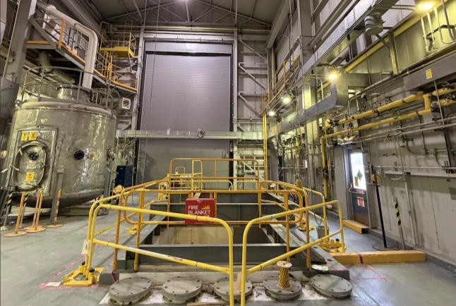
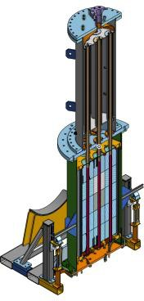
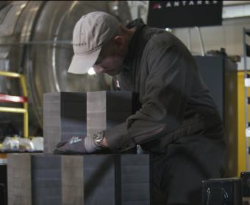
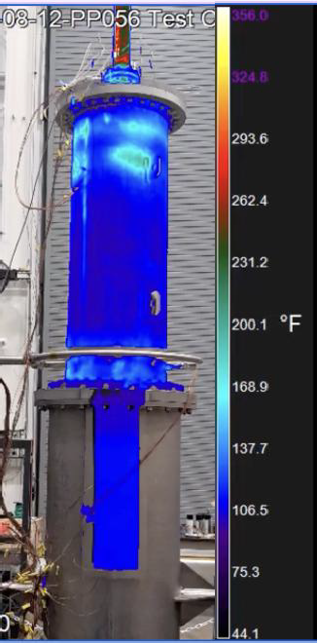
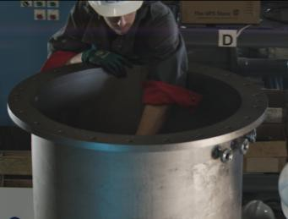
Differentiate through demonstration
O U R A P P R O A C H
Between electrically heated systems and full nuclear demonstration units, Antares intends on building multiple prototypes prior to fielding the first production unit.
A subscale electrically-heated reactor core + heat exchanger prototype has been demonstrated up to 800 °C. Additional tests will continue through 2029.
A nuclear pilot reactor will be deployed at Idaho National Laboratory in 2026.
Funded by Antares under $40M contract to INL
HALEU allocated by DOE; TRISO fuel fabrication underway
Preliminary design reviews completed with INL
Preliminary Documented Safety Analysis (PDSA) Approved by DOE
A full power reactor producing electricity from nuclear energy will be operated in 2027.
Conceptual design accepted by INL
Power conversion system in development
We are exercising the Department of Energy licensing pathway, which will accelerate regulatory review for Department of War and Nuclear Regulatory Commission.
Design
Build
Test
Low-rate production units will be available by 2028.
6

Slide 25
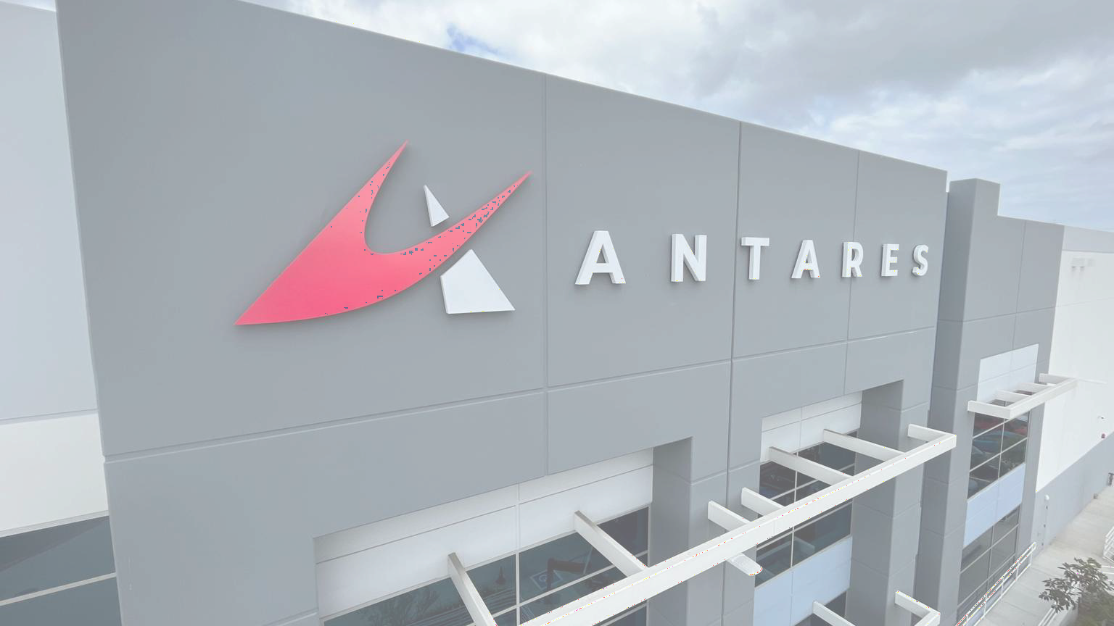
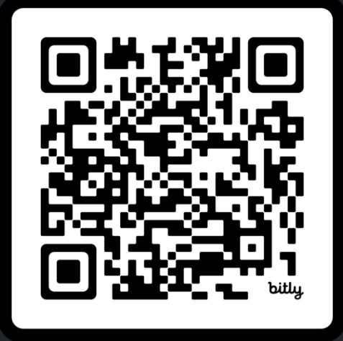
Q&A
Follow Us on LinkedIn

Slide 26
Center for Used Fuel Research Designation
Dr. Jess Gehin, Associate Laboratory Director for Nuclear Science and Technology, Idaho National Laboratory

Slide 27



Center for Used Fuel Research
Dr. Jon Carmack Acting Director
Center for Used Fuel Research January 2026

Slide 28
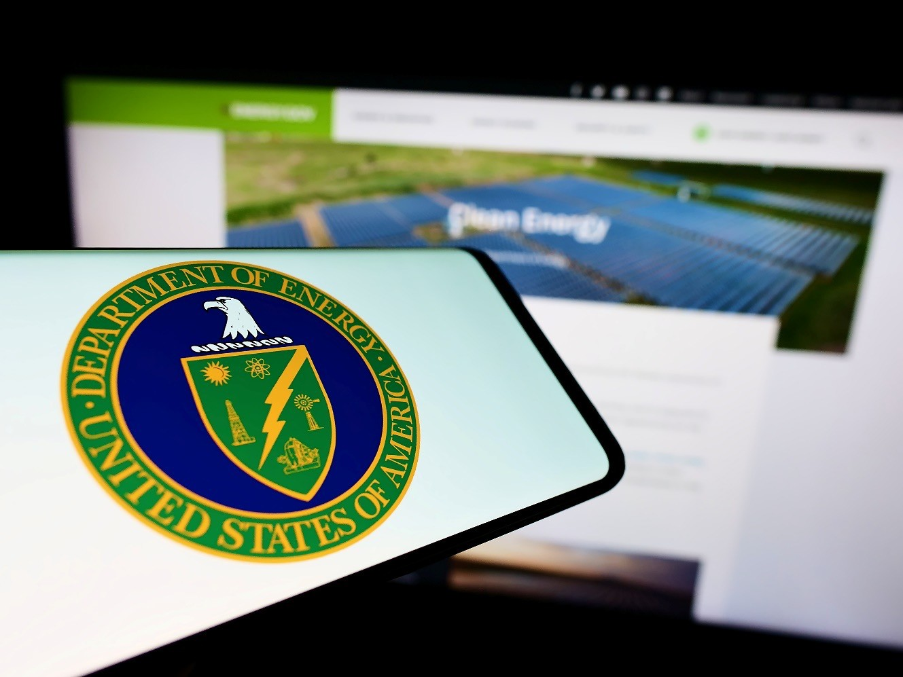
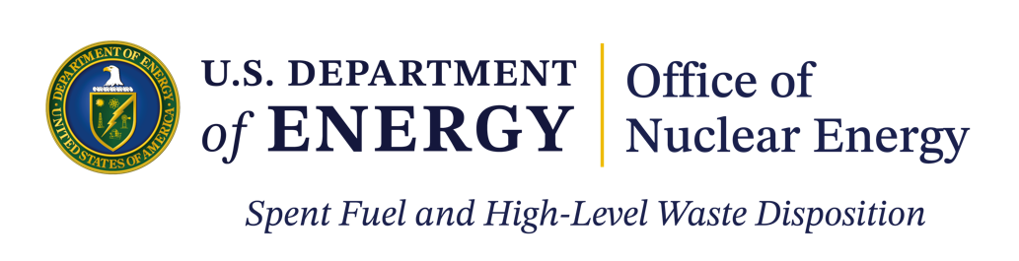
DISCLAIMER
This is a technical presentation that does not take into account contractual limitations or obligations under the Standard Contract for Disposal of Spent Nuclear Fuel and/or High-Level Radioactive Waste (Standard Contract) (10 CFR Part 961).
To the extent discussions or recommendations in this presentation conflict with the provisions of the Standard Contract, the Standard Contract governs the obligations of the parties, and this presentation in no manner supersedes, overrides, or amends the Standard Contract.
This presentation reflects technical work which could support future decision making by the U.S. Department of Energy (DOE or Department). No inferences should be drawn from this presentation regarding future actions by DOE, which are limited both by the terms of the Standard Contract and Congressional appropriations for the Department to fulfill its obligations under the Nuclear Waste Policy Act including licensing and construction of a used nuclear fuel¹ repository.
2
¹The term “used nuclear fuel” is intended to be synonymous with the term “spent nuclear fuel” as used and defined in the Nuclear Waste Policy Act of 1982, as amended, and the Standard Contract for the Disposal of Spent Nuclear Fuel and/or High-Level Radioactive Waste (10 CFR Part 961).

Slide 29
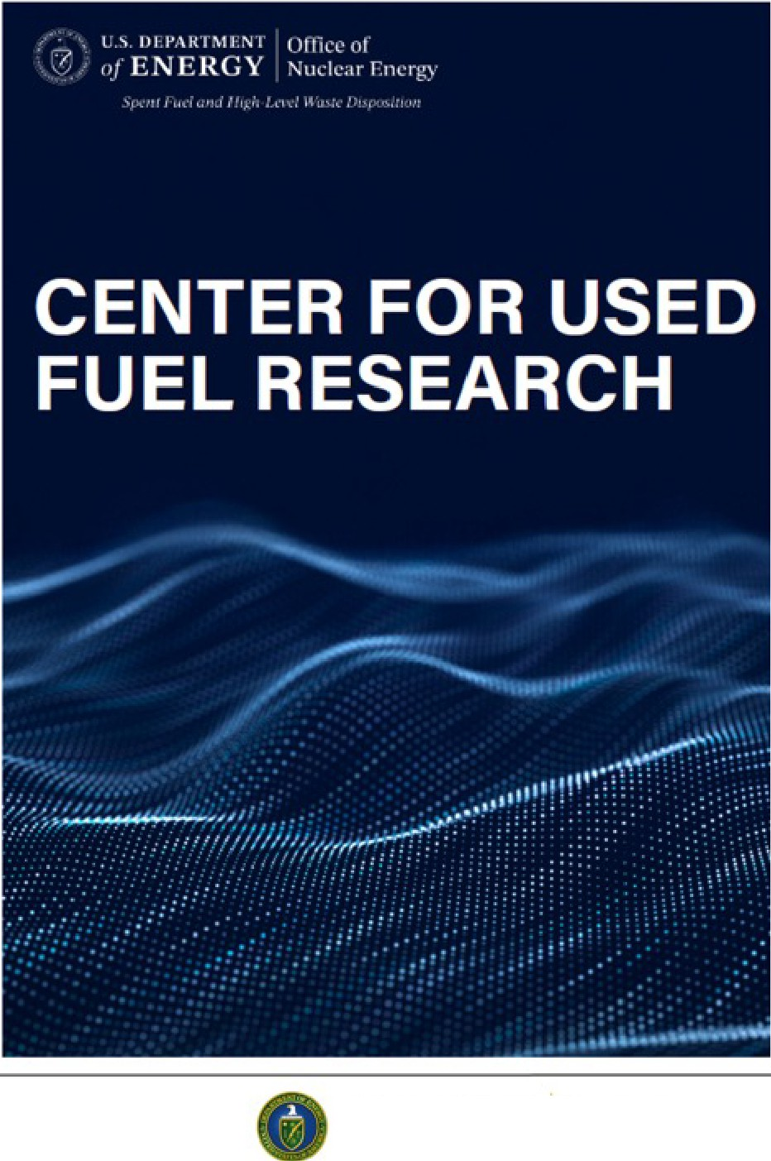
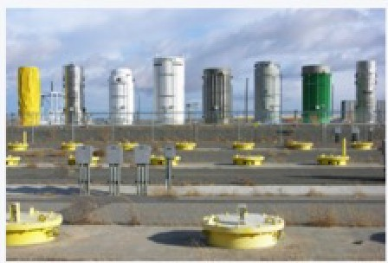
Center for Used Fuel Research (CUFR) Established at /NL -
January 14, 2026
De9artment of EnergY. Establishes Center for Used Fuel Research at Idaho National LaboratorY.
U.S. Department of Energy designates Idaho National Laboratory as
its leading institution for critical research, development, and demonstration efforts concerning used nuclear fuel management.
https://www.energy.gov/ne/articles/department-energy-establishes-center-used-fuel-research-idaho-national-laboratory
Coordinate efforts in developing innovative technologies and solutions, conduct applied research that helps support and maintain regulatory compliance, and enable public confidence in the storage and transportation of commercial and DOE-managed UNF.
Mission:
17
U.S. OEPARTMENT Office of
of ENERGY Nuclear Energy
Spent Fuel and Hi�h·Lfllel Wasre Dispo.sitio1i

Slide 30
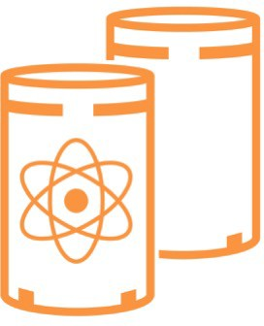


Mission and Goals of the Center for Used Fuel Research
Coordinate efforts in developing innovative technologies and solutions, conduct applied
Mission: research that helps support and maintain regulatory compliance, and enable public confidence in the storage and transportation of commercial and DOE-managed UNF
Reduce DOE’s contractual (~$39 - $44 billion) and technical liabilities (TBD)
Leverage U.S. and international research and operational experience Furnish data and methods to support extended storage and transportation
4

Slide 31










































CUFR Organization
DOE-EM
NE-8 Deputy Assistant Secr.
National Labs
Tribal Communities
Executive Advisory Board
Director
State
EPRI
NEI
Deputy Director of
Legal and
Industry and International Engagement
Applied Research
Compliance
Communications
Board Observers – DOE-NE, DOE-EM,
and NRC

Slide 32
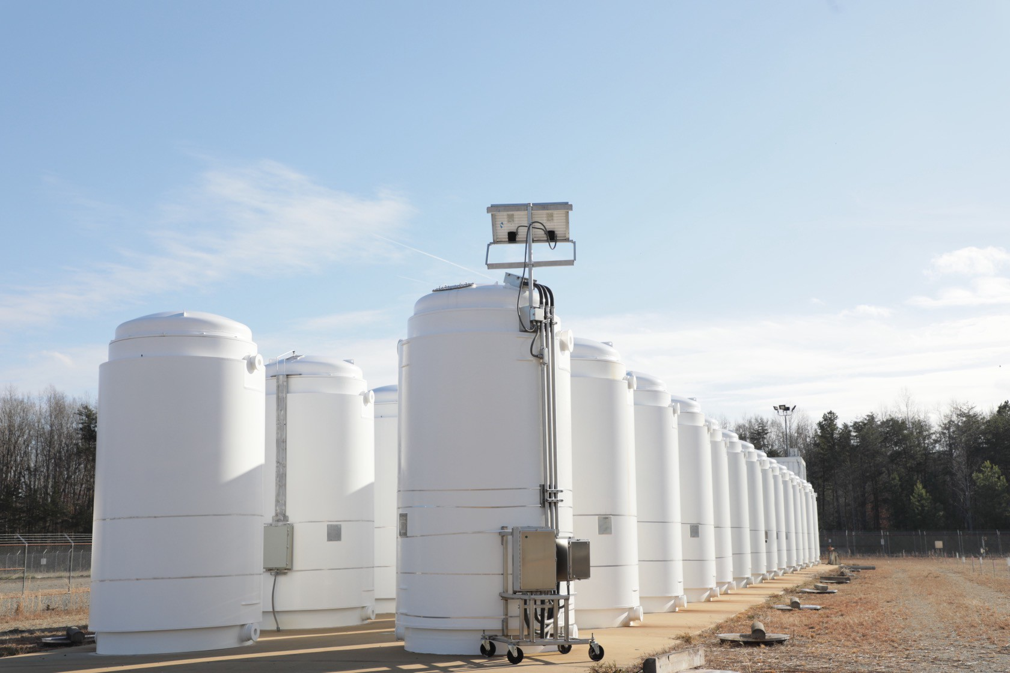
CUFR Work Scope and Products
Scope
Focuses on long-term canister and content performance
Will assist with centralized storage, UNF transportation, disposal, and developing alternative designs and technologies at storage facilities
Proposed activities
Emerging Issues (1 year)
Technical Gap Closures (3 years)
First-of-a-Kind Research (>3 years)
Clear objectives with defined outcomes
DOE is moving the cask to INL to support studies of UNF in storage in 2027.
6

Slide 33



High Burnup Research Cask (HBURC) is a High Priority
Over 50 Nuclear Power Plants in 28 States are relying on the collection of data from the UNF within the HBURC to support licensing of extended storage
Collect initial discharge data from loading and initial period of storage
Collect greater than 10-year
storage data
Compare discharge and time in storage data
Data supporting industry innovation in UNF
management
Increasing operational design space for UNF management
Using the HBURC data to meet the NRC
regulations
DOE future data needs
Safe long-term UNF management
7

Slide 34
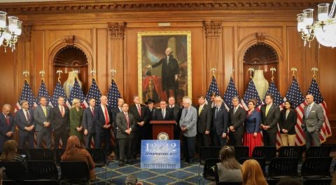
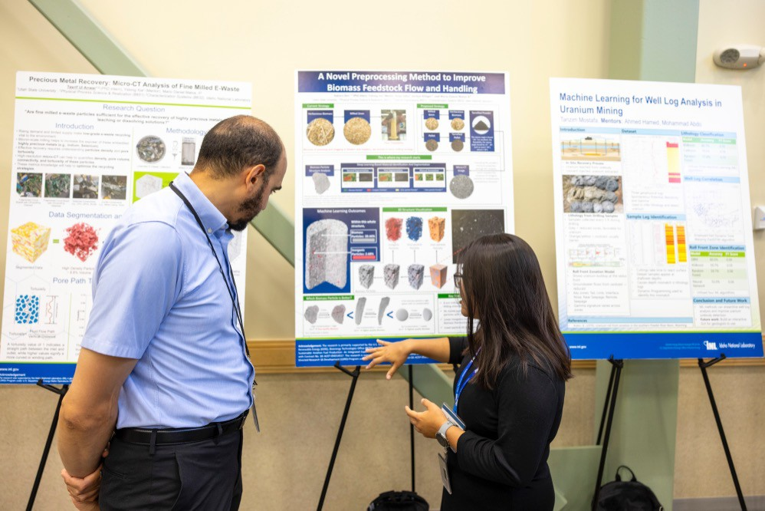
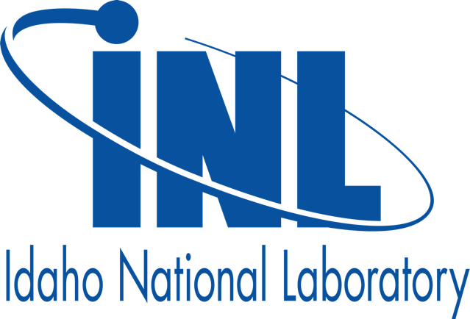
Economic Impact
CUFR Investment
Energy and Water Development and Related Agencies Appropriations Act, 2026 (H.R. 6938) provides $10 Million for the development of the CUFR.
INL Support
The Director of the CUFR will be an INL employee. The CUFR will serve as the research arm of DOE Office of Spent Fuel and High-Level Waste’s sub-Office of Storage & Transportation, receiving both current and future funding streams.
Tribal Collaboration
INL will establish two internships for the Shoshone-Bannock Tribes in fields to support the CUFR.
8

Slide 35

Partners to the CUFR
The CUFR will operate out of INL based on a hub-and-spoke model
Hub = physical and intellectual location
Spokes = principal partners, associates, and other participants
Accountable to the Deputy Assistant Secretary for Spent Nuclear Fuel and High-Level Waste Disposition
Executive Advisory Board with external membership provides strategic guidance to CUFR director
U.S. Industry/Electric Power Research Institute
Universities through DOE NEUP awards
Small Companies through the SBIR awards
International programs
9

Slide 36
The Center for Used Fuel Research: Summary
DOE announce creation of the Center for Used Fuel Research (CUFR) on January 14, 2026.
Mission: Coordinate efforts in developing innovative technologies and solutions, conduct applied research that helps support and maintain compliance, and enable public confidence in the storage and transportation of commercial and DOE-managed UNF.
Goal 1: Reduce DOE’s contractual and technical liabilities associated with the management of UNF prior to undergoing permanent disposal.
Goal 2: Leverage lessons-learned from countries with established UNF storage and transportation programs
Goal 3: Furnish data and methods to support extended storage and transportation of UNF prior to disposal.
The CUFR will operate using a hub-and-spoke model to enhance collaborations with other laboratories, industry, and academia.
The CUFR’s activities will have clear objectives with defined outcomes.
10

Slide 37


Slide 38
Working Lunch
The Task Force will reconvene at 1 PM

Slide 39
Idaho Nuclear Development Incentives RFI Results
Cally Younger
Administrator
Idaho Governor’s Office of Energy and Mineral Resources

Slide 40
Request for Information Goals
Identify key factors influencing site selection decisions
Understand infrastructure requirements and preferences
Assess regulatory and permitting considerations
Evaluate workforce and talent needs
Determine effective incentive structures
Explore partnership opportunities with state agencies and institutions
Gather input on potential barriers to investment

Slide 41
SCOPE OF INFORMATION REQUESTED
Company Profile and Experience
Site Selection Criteria
Infrastructure Requirements
Regulatory and Permitting Considerations
Economic and Financial Considerations
INCENTIVE PREFERENCES AND PARTNERSHIP OPPORTUNITIES
Financial Incentives
Partnership Opportunities
Regulatory Support
COMPETITIVE ANALYSIS
Alternative Locations
Decision Timeline
BARRIERS AND CHALLENGES
Potential Obstacles
Risk Mitigation

Slide 42
Summary of Key Responses

Slide 43
Company Profile and Experience

Slide 44
Company Information
15 responses received
Advanced Nuclear Advisors, BWXT, Curio, ESI Construction, ESTECH, Guidehouse, Holtec International, Kiewit, Management Solutions, Micronuclear Technologies, Next Era Energy, Oklo, Project Omega, Westinghouse, Zetta Joule
Respondent diversity
Old and new companies (established 1884 versus less than one year)
Well-established Fortune 500 companies versus startups
Owner/operators, reactor technology, construction, consultants, used fuel management

Slide 45
Idaho Interest Level
Interest driven by INL
Some respondents already work with Idaho companies such as Premier
Some already have congressional and local legislative support

Slide 46
Site Selection Criteria

Slide 47
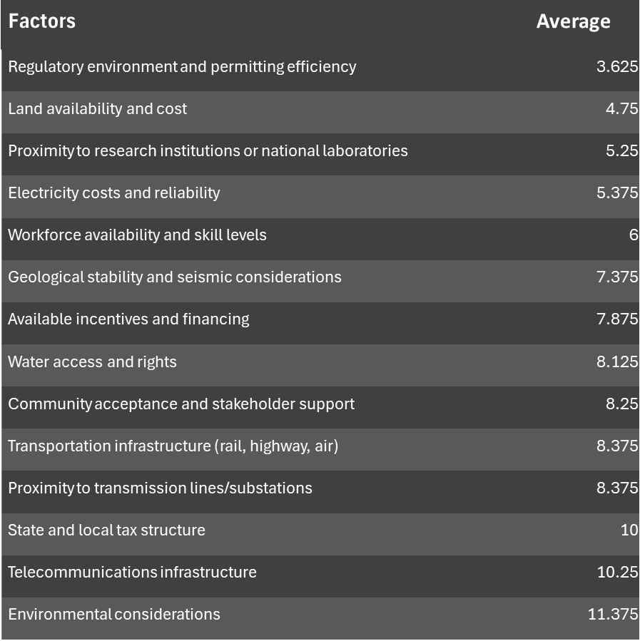
Primary Location Factors
Lower score indicates higher priority
Development dependent on availability of transmission and water infrastructure, land availability, workforce development, and available financing
Deal breakers
Lack of regulatory clarity
Fragmented permitting
Lack of community support, transmission, water
availability
Weak financing

Slide 48
Infrastructure Requirements
Electrical Infrastructure
Greater power, voltage, and transmission demands
Some projects may need 100+ MW during operations
Projects require transmission, distribution, and substation upgrades
Redundant/backup power for 24/7 operations
Differences in interconnection requirements may slow projects
Physical Infrastructure
Land: Requirements vary by project demands
Water:
Cooling, reactor operations, daily operations safety systems
For some projects, predictability is more important that sheer volume
Transportation: Rail, highway/interstate access, heavy haul routes needed
Telecommunications: Must be secure and reliable
Physical and Cybersecurity: Required; depends on operational requirements
Workforce Requirements
Demands are highest during construction
Need both trades and high skilled professionals
Building more specialized training upon Idaho’s established training pipelines through ISU and INL, other trade programs
Require a mix of temporary, permanent, and affordable housing; and community services

Slide 49
Regulatory and Permitting Considerations
Permitting Priorities
NRC/DOE, State, and Local planning and zoning
Permitting timelines depend on the project (6 months – 6 years)
Biggest permitting laws: NEPA, CAA, CWA, RCRA, ESA, NHPA, State/Local
Developers prefer highly coordinated, centralized process and communications
Regulatory Environment
Challenges:
Community/political opposition (Difficult to navigate and can delay or halt a project)
Multi-layered approvals/Separated permitting processes (Larger permits [e.g., wetlands] are difficult, stakeholder engagement and coordination, individual permit timelines vary)
Opportunities: “one stop permitting shop,” standardizing timelines, prefiling project details

Slide 50
Economic and Financial Considerations
Investment Profile
Typical capital investment
All projects: $25 million - $10 billion
Small modular reactors: $1-3 billion
Large projects: >$6 billion
Reactor types:
high temperature gas reactors, SMRs, AP1000s, molten salt nuclear batteries
“Nth of a Kind” reactors are preferred over “First of a Kind”
Construction timeline: Varies; 2-4 year construction to operations timeline
Permitting timelines: Varies; NRC licensing can add 12-36 months
Expected operational lifespan: NRC licenses begin at 40 year durations with voluntary option to extend. Built to operate >20/30/50 years.
Economic Impact
Economic impact was concentrated in jobs. ~$100k average construction wage, tens of millions in total wages during construction
Scaling effects of reactor development: High wages, more tax revenue, industrial diversification, greater aggregate consumer demand.
Sales and property taxes bring millions to local communities
Indirect employment multiplier: 1.5 - 3.5
Indirect economic multiplier: 1.8 - 3.0

Slide 51
Incentive Preferences and Partnership Opportunities
Asked to rank and briefly explain the importance in selecting project location

Slide 52
Tax Incentives
Property tax abatements or exemptions
Often preferred because nuclear projects carry large upfront capital invests with long construction period. Early tax relief significantly enhances financial feasibility and encourages multi-unit buildout.
For example, 100 – 50% abatements during construction or 100 – 75% property tax abatement for 15 years
Can be gradually decreased over time. Phased-in property tax may support predictable municipal revenue growth.
Sales tax exemptions on equipment and materials
Preferred by suppliers/developers who do not own property
Personal income tax considerations for relocated workforce
Corporate income tax credits or reductions
Special assessment districts or tax increment financing

Slide 53
Direct Financial Support
Targeted grants and direct subsidies
Infrastructure development cost-sharing (transmission and water)
Low-interest loans or loan guarantees
Workforce training and development funding
Research and development tax credits

Slide 54
Non-Financial Incentives
Expedited permitting and regulatory review/dedicated project management and liaison services (liaison, primarily)
Infrastructure development partnerships
Workforce development program partnerships
Marking and promotional support (public relations, campaigns)

Slide 55
Partnership Opportunities
State institution partnerships
INL
University research & state and technical schools
Technology transfer and innovation partnerships
Infrastructure partnerships
Public-private partnerships for infrastructure development
Joint development of transmission or transportation infrastructure
Shared services or facilities with other industrial users
Regional economic development collaborations

Slide 56
Regulatory Support
One-stop permitting and approval processes
Dedicated regulatory liaisons
Pre-approved site certification programs
Master planning and zoning support
Environmental review coordination

Slide 57
Competitive Analysis

Slide 58
Alternative Locations
Texas, Tennessee, Utah, Wyoming, Louisiana, Washington (workforce development grants), South Carolina (streamlined permitting process, P3 funds).
Just about any nuclear-friendly state that has a national laboratory.
Developers consider:
States with aggressive financial incentives
Mature nuclear workforce
Existing nuclear sites
Demand from large loads
Expedited regulatory pathways
Good infrastructure
Multi-site nuclear deployment strategies

Slide 59
Decision Timeline
Federal permitting processes often dictate much of the timelines
Driven by permitting, certainty, coordination, straightforward and predictable site access, and data collection
Opportunities: Permitting certainty, public support, site information and derisking strategies
Threats: Uncertainty, lack of early site data, insufficient coordination
For example: Site selection for SMR project may take about 12 – 18 months

Slide 60
Barriers and Challenges

Slide 61
Potential Obstacles and Risk Mitigation
Obstacles
Regulatory/permitting challenges
Infrastructure limitations/gaps, interconnection timelines
Available financing
Workforce availability
Liability (used nuclear fuel)
Risk Mitigation
Long-term policy predictability
Early site derisking through NRC Early Site Permit (KY)
State incentive programs to alleviate financial difficulties
Quality Assurance Requirements and Description (NRC)

Slide 62
Key Takeaways and Themes

Slide 63
Key Takeaways
How does Idaho want to operate in the nuclear ecosystem?
Early, consistent coordination is key for programmatic derisking
Coordinated strategy for permitting, environmental review, workforce development, and financial support
Opportunities for regulatory support

Slide 64
Questions

Slide 65
National Reactor Innovation Center
Sam Reiss, Senior Manager, National Reactor Innovation Center

Slide 66
National Reactor Innovation Center
NRIC Program and Private Nuclear Siting at INL
February 2026
Sam Reiss
Senior Manager
National Reactor Innovation Center
Samuel.Reiss@inl.gov
MIS-25-85413

Slide 67
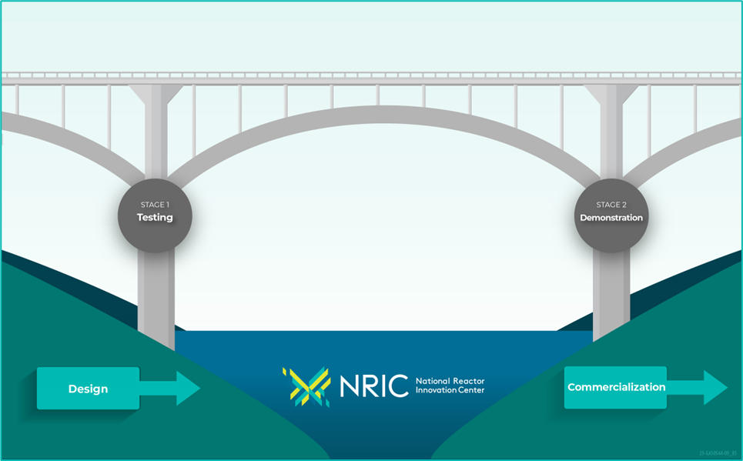
The National Reactor Innovation Center (NRIC) is a DOE program launched in FY 2020 under Trump Administration
NRIC Enables Nuclear Reactor Tests & Demonstrations
Authorized by the Nuclear Energy Innovation Capabilities Act (NEICA)
Department of Energy (DOE)-Office of Nuclear Energy (NE-5)
Located at INL under Nuclear Science & Technology
Partner with industry to bridge the gap between research and commercial deployment
Leverage national lab expertise and infrastructure

Slide 68


NRIC Portfolio Built to Empower Innovators
Advancing Reactor Testing
Advanced Reactor Test Beds
Experimental Facilities
Siting Advanced Reactors
Virtual Test Bed
Addressing Costs & Markets
Advanced Construction
Digital Engineering for Nuclear
Maritime Applications
Portfolio created to fill gaps identified by industry

Slide 69

NRIC-DOME Test Bed
Demonstration of Microreactor Experiments (DOME)
DOME is the repurposed EBR-II structure
Designed for Advanced Microreactors up to 20MW_{th}
Designed for High-Assay Low-Enriched Uranium (HALEU) fuels < 20% enrichment
Accommodates ISO 668 High-Cube Shipping Containers up to 40ft long.
480V / 400Amp electrical Service
≈ 78 ft diameter floor space with an 80ft ceiling
300kWth of environmental cooling expandable to 500KW_{th}

Slide 70











DOME Ecosystem
To perform reactor experiments it takes more than just the DOME facility, it requires integration of additional infrastructure, partners, procedures, and processes
Reactor footprint
Future Cooldown Pad (RSWF)
TRISO Fuel manufacturing
Defuel & Dispose Reactor
Used Fuel
Reactor
Fuel Shipping
Reactor Shielding
RSWF Used Fuel Storage
Storage in CPP-651
Reactor

Slide 71




NRIC Experimental Infrastructure
Helium Component Test Facility [2022]
In-HotCell Thermal Creep Frame [2025]
Mechanisms Engineering Test Lab (METL) [Operating since 2018]
Molten Salt Thermophysical Examination Capabilities (MSTEC) [2025]

Slide 72
Reactor Developer Support and Siting at INL

Slide 73



INL is a Key Participant in Advanced Reactor Demonstration Program (ARDP) Projects
Risk Reduction
Demonstration
9 projects supported
Wide variety of reactor types
Scope range
Modeling & Simulation
Irradiation & PIE
Fuel design & fabrication
>$200M – 7 years
NRIC/INL Coordinator
NRIC Deployed Digital Engineering and project management tools
Concept Development

Slide 74


Oklo Aurora Reactor
Oklo is a publicly traded company developing sodium-cooled fast reactors based on proven technologies developed at INL (e.g., EBR-I, EBR-II)
Aurora Reactor
DOE Authorization through Pilot Program
75 MWe
Groundbreaking Sept 22, 2025
Goal to begin operation in 2028
DOE competitively awarded Oklo with 5 MT of HALEU material recovered from EBR-II driver fuel
Fuel fab facility to be constructed at MFC
DOE authorized
PDSA submitted to DOE – Oct 2025

Slide 75
Aalo-X Reactor
Aalo Atomics
Selected for DOE Reactor Pilot Program
Signed Other Transaction Authority (OTA) agreement with DOE
Planned as DOE authorized test
Aalo-X Reactor
Liquid Metal Reactor, Sodium Cooled Thermal Reactor
UO2 fuel pins and graphite moderated core
Final design under development
20 MWth
5% enriched UO2
Aalo signed agreement with Urenco to supply fuel
Groundbreaking held August 28 after receiving the Environmental Compliance Permit
Aalo’s goal is to have a dry criticality experiment by July 4, 2026

Slide 76











DOE Reactor Pilot Program project selections
“President Trump’s Reactor Pilot Program is a call to action. These companies aim to all safely achieve criticality by Independence Day, and DOE will do everything we can to support their efforts.”
James P. Danly, Deputy Secretary of Energy

Slide 77


DOE Advanced Nuclear Fuel Line Pilot project selections
The Fuel Line Pilot Program supports the Reactor Pilot Program by establishing a domestic nuclear fuel supply chain for testing new reactors. It uses DOE authorization to build and operate nuclear fuel production lines for research, development, demonstration, and expedited commercial licensing.

Slide 78
Launch Pad: The Next Phase of Advanced Nuclear Siting

Slide 79

Why Create Launch Pad
Launch Pad will be a centralized location for advanced nuclear deployments
Allows for shared use of physical and support resources
Expedites advanced nuclear deployments
Logical next step from DOE Pilot Programs
*AI generated image

Slide 80

Launch Pad Proposed Site
Planned Launch Pad is 2100+ acres around INL’s Central Facilities Area
Limits impact to core lab operations
Proximity to utilities
Rail line access
Large footprint

Slide 81

Gathering Industry Input to Make Launch Pad Successful
Conducted interviews with 10 companies (9 reactor developers, 2 fuel fabricators, Oklo as both) on what they want from Launch Pad
Aalo, Antares, BWXT, Deployable Energy, Nano Nuclear, Oklo, Radiant, Standard Nuclear, Westinghouse, X-Energy
One-month RFI on SAM.gov for additional input

Slide 82
Key Feedback Received
ALL DEVELOPERS ASKED FOR A FEW KEY ITEMS
Access to basic infrastructure (electricity, water, fiber, roads, etc.)
General access, not run to their site border
End users for the electricity or heat Collaboration with Proving Ground
Back-end management Storage or another solution
OTHER ‘NICE TO HAVE’ ITEMS
NEPA/Environmental permitting
Access to INL facilities, personnel, safety programs, safeguards and security
DOE/NRC regulatory support
Streamlined contracting
Onsite transportation and handling

Slide 83

Launch Pad will enable NRIC and INL to continue to provide the support advanced nuclear developers need at the speed these start-up companies expect

Slide 84
Discussion and Questions

Slide 85
State Policies Supporting Nuclear
Dr. Jess Gehin, Associate Laboratory Director for Nuclear Science and Technology, Idaho National Laboratory

Slide 86










February 2, 2026
Jess C. Gehin, PhD Associate Laboratory Director Nuclear Science & Technology Jess.Gehin@inl.gov
State Policies Supporting Nuclear
Presented to:
Idaho Advanced Nuclear Energy Task Force Boise, Idaho

Slide 87
Topics
Overview of State-Level Nuclear Support Policies
Best Practices from Leading Nuclear States
Tools, Regulatory Streamlining Permitting Reform
Workforce Development Activities
Q&A
Inputs from:
Idaho National Laboratory: https://www.inl.gov
Gateway for Accelerated Innovation in Nuclear: https://gain.inl.gov Nuclear Energy Institute: https://www.nei.org
NEI Resources and Report : https://www.nei.org/resources/reports-briefs/state-legislation-and-regulations
2

Slide 88

What States Does the American Nuclear Society call “The Top States of Nuclear”?
Tennessee: The epicenter
Texas: Big state, big plans
Idaho: A great place to test
Virgina: Is for Nuclear
Washington: Amazon delivers SMRs
North Carolina: Fuel Forward
Illinois: Nuclear’s Birthplace
South Carolina: Max AP1000 Potential
Pennsylvania: A nuclear keystone
Honorable Mentions: Utah, Wyoming, Georgia, California, Wisconsin, New York, New Mexico
10. Michigan: Initiating the revival
https://www.ans.org/news/article-7645/the-top-10-states-of-nuclear/
3

Slide 89





2025 state nuclear legislation
As of December 1st, 279 bills have been introduced in 2025 with 73 enrolled into law.

Slide 90


What Policies are States Implementing?
Establishing New Permitting & Licensing Pathways
Siting & Permitting
Supporting Development Through Cost Recovery
States set or direct rules for nuclear permitting and licensing (e.g., Maryland, Kentucky)
Centralized or expedited permitting processes adopted (e.g., West Virginia, Indiana), and efforts to ease zoning and siting for small modular reactors (e.g., vetoed Arizona bill)
States enabling partnerships and long-term contracting for nuclear projects (e.g., Indiana, Rhode Island)

Slide 91

State Policies Used by States to Enable Nuclear Energy Development
6

Slide 92

Best Practices from Leading Nuclear States

Slide 93

Tennessee: #1 Nuclear State Case Study
"The Epicenter" — How State Policy, Federal Assets & Private Investment Align
8

Slide 94

State Regulatory Streamlining & Permitting Reform
Comparing Traditional vs. Modernized Approaches
9

Slide 95

Tools & Resources for State Nuclear Development
Federal, Industry, and Policy Organization Support Available to States
10

Slide 96


State nuclear feasibility studies and working groups
31
feasibility studies covering a range of topics including policy, technical, and economic analyses
20 studies have been completed
2 pending completion by end of 2025
8 pending completion by end of 2026 or later
There are active working groups in Arizona, Hawaii, Idaho, Louisiana, Ohio, Oklahoma, Tennessee, and Virginia
There are active regulatory dockets in Arizona, Kentucky, and Oklahoma

Slide 97
Regional Profile: Western States Advancing Nuclear Frameworks
Utah: Operating Gigawatt. Funding for nuclear deployment initiatives; establishment of nuclear governance, research, and coordination entities
Washington: State funding to support federal licensing and financing for new nuclear development
Montana: Regulatory pathways for spent fuel storage and uranium conversion and enrichment facilities
Wyoming: Updated state approval requirements for high-level radioactive waste storage

Slide 98

Nuclear Work Force Development Pipeline
13

Slide 99


RFI for State Input on Nuclear Lifecycle Innovation Campus Responses Due April 1st
14

Slide 100

Battelle Energy Alliance manages INL for the U.S. Department of Energy’s Office of Nuclear Energy. INL is the nation’s center for nuclear energy research and development, and also performs research in each of DOE’s strategic goal areas: energy, national security, science and the environment.

Slide 101
Creation of Working Groups and Next Steps
Lt Gov. Scott Bedke, Co-Chair
Director John Wagner, Co-Chair

Slide 102
Public Comment and Adjourn
Lt Gov. Scott Bedke, Co-Chair
Director John Wagner, Co-Chair

